Slide 1
NUS RoboMaster Team 2020 Meet & Greet
31st Aug 2019 10.30am
Notes:
https://www.youtube.com/watch?v=dlOEqCMw1xI&t=609s (What Are We Fighting For——RoboMaster 2019 Ep 12 RoboGrinder at Virginia Tech)

Slide 2
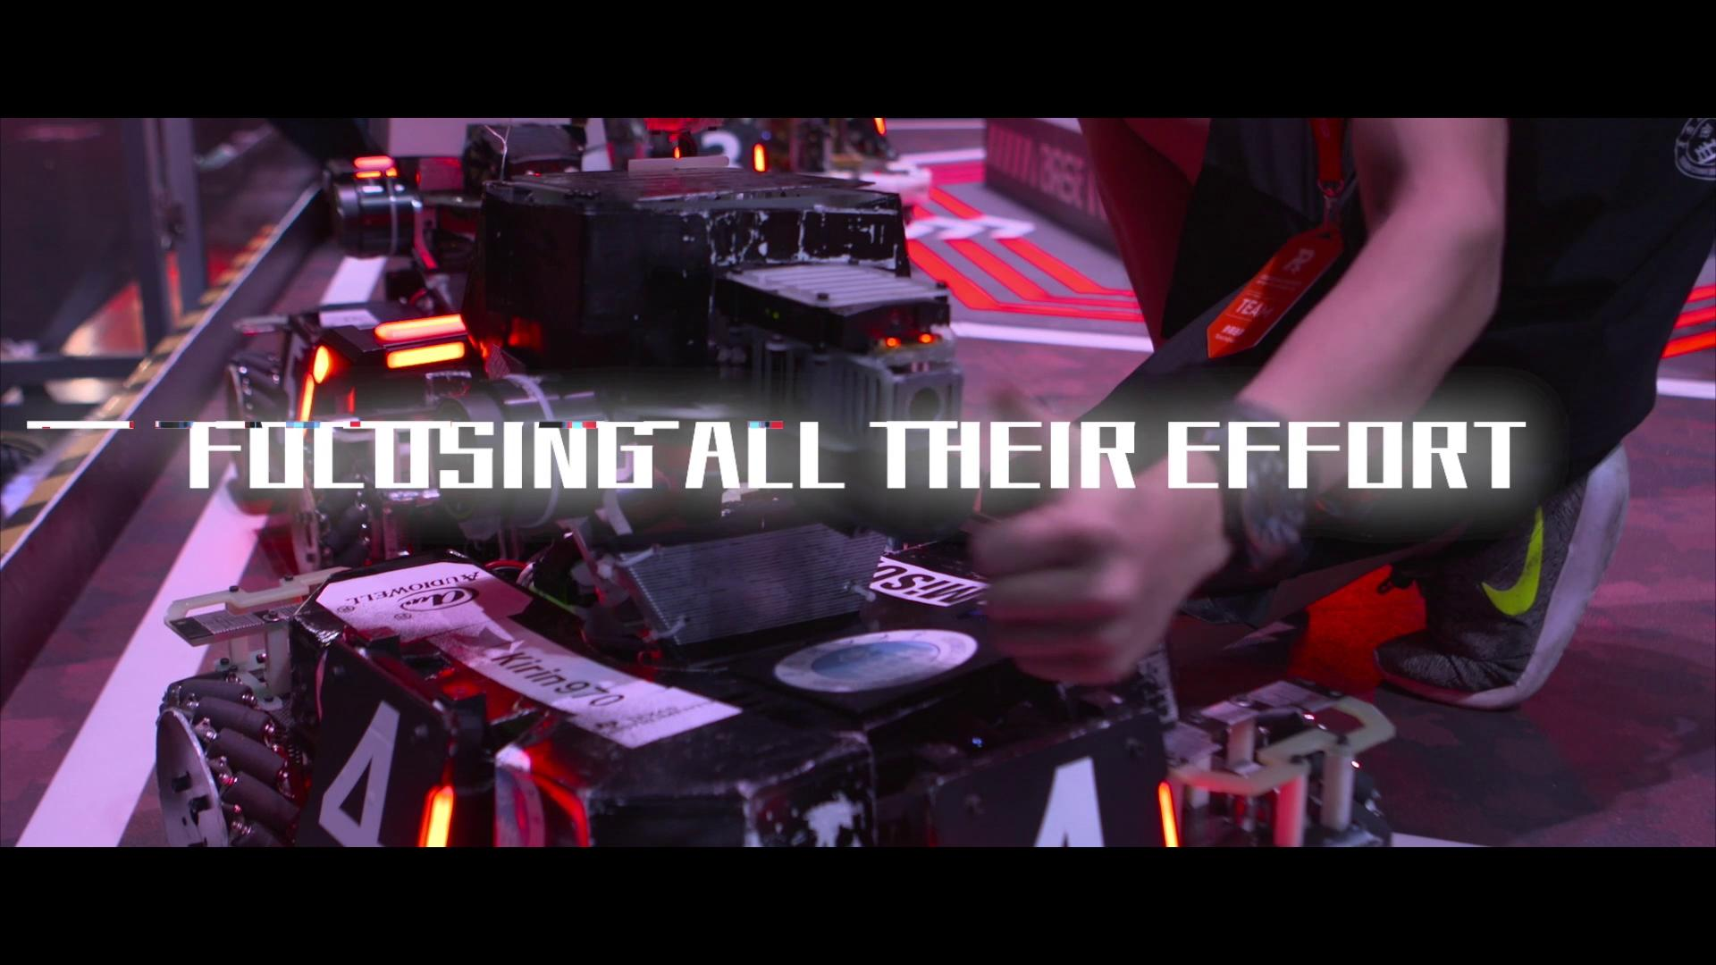

Slide 3
Introducing
the COOLEST
Robotics Competition
Notes:
RoboMaster Robotics Competition officially launched in 2015, until this 2019 August season, it is the fifth year being hosted. Hosted by DJI
Quote
RoboMaster requires students to walk out of the classroom, form a robotics team, and independently develop and produce a variety of robots to participate in a large-scale competition. Participants gain valuable technical skills as well as critical thinking skills throughout the competition. They are able to combine theory and practice, and build advanced intelligent robots to face in a fierce competition.
Each RoboMaster event aims to incorporate the most up and coming technology in the field of robotics such as computer vision, embedded systems, and artificial intelligence.
The RoboMaster Robotics Competition has attracted the interest of hundreds of colleges and universities, nearly 1,000 tech companies and organizations and tens of thousands of robotics enthusiasts around the world. It’s unique gameplay, technical difficulty, and competitive style are just a few reasons why RoboMaster is captivating the world.
Quote End

Slide 4
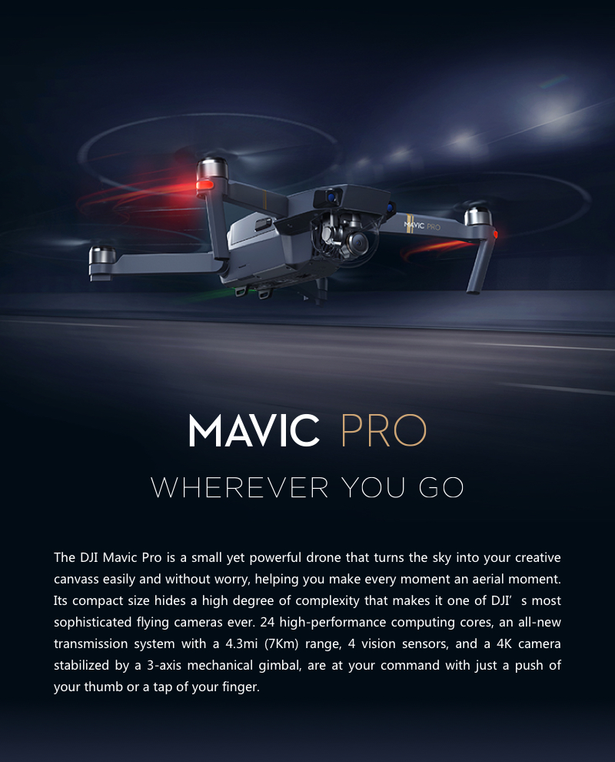
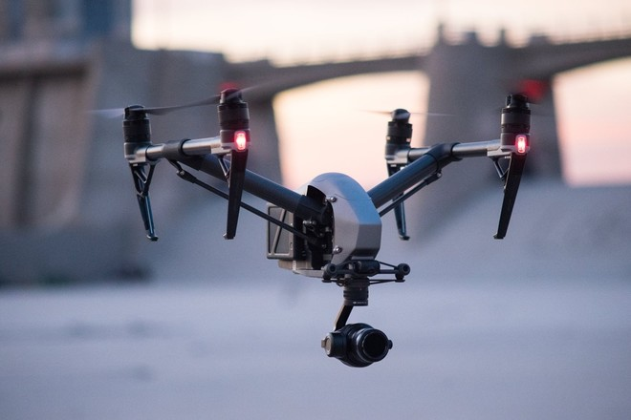

Slide 5
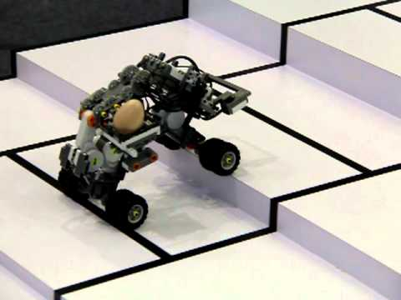
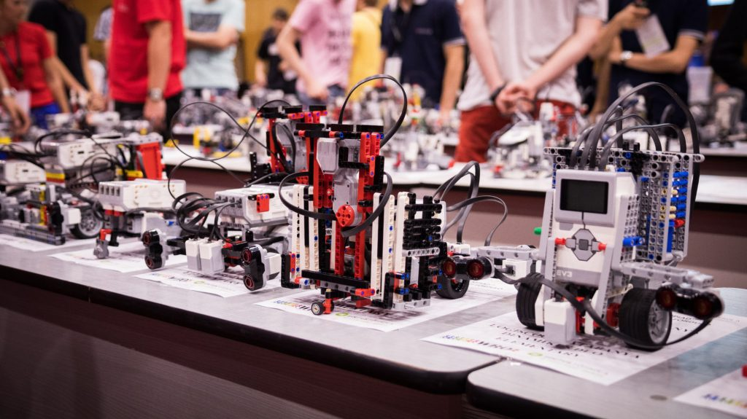
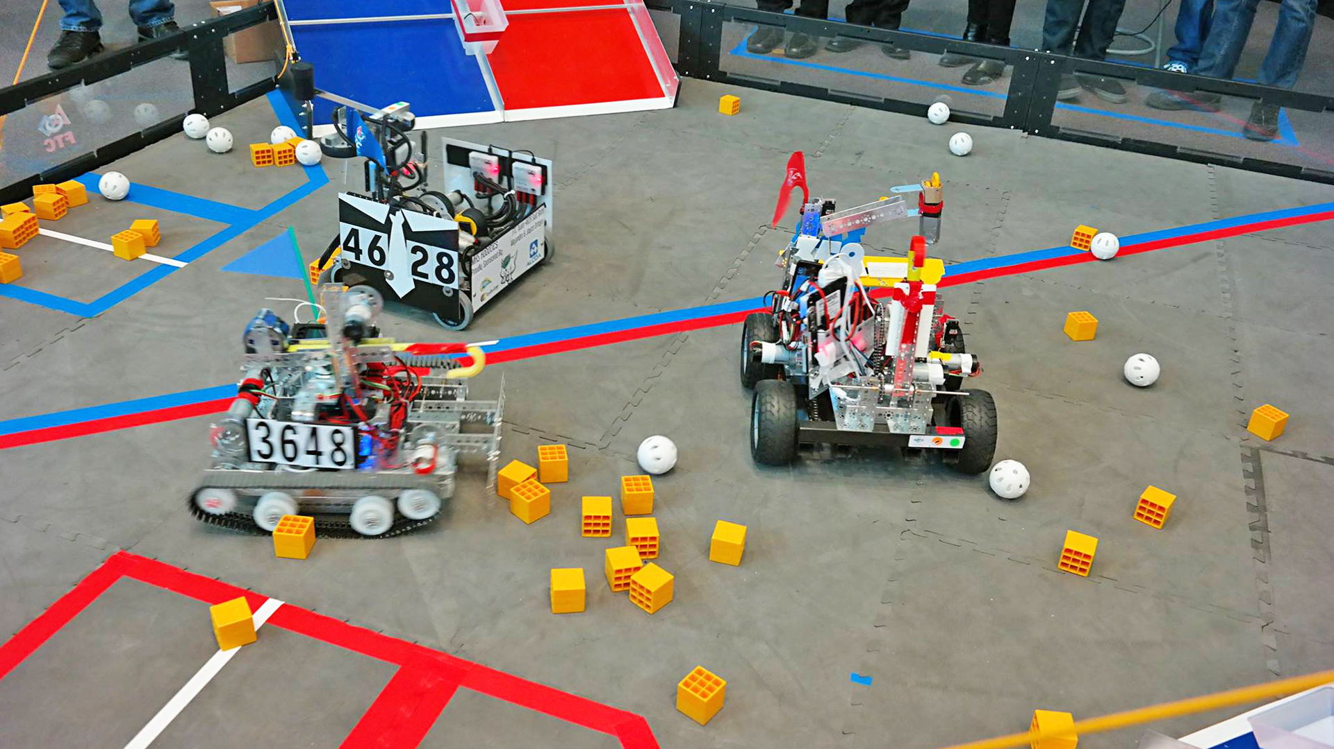
They Can Be Educational
Specific tasks, structured environments
Notes:
Make a nice hackathon or semester module project. But probably not more than that.

Slide 6
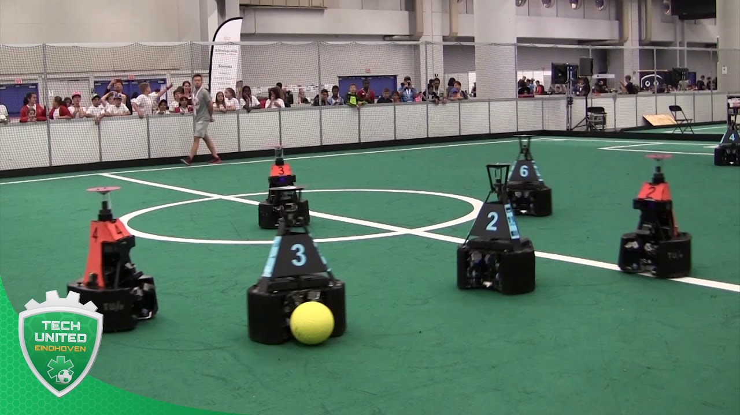
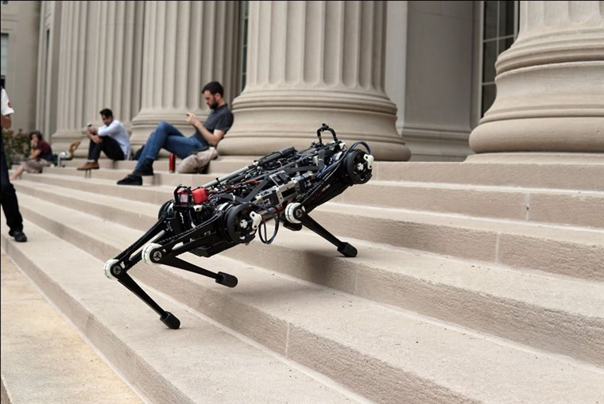
They Could Be Great Research Topics
More generic tasks, complex environment
Notes:
Take lots of effort to understand and implement the state-of-the-art
Might be too high a place to start a place, if you are just into robotics
Can’t start tinkering immediately, in short, not as fun.

Slide 7
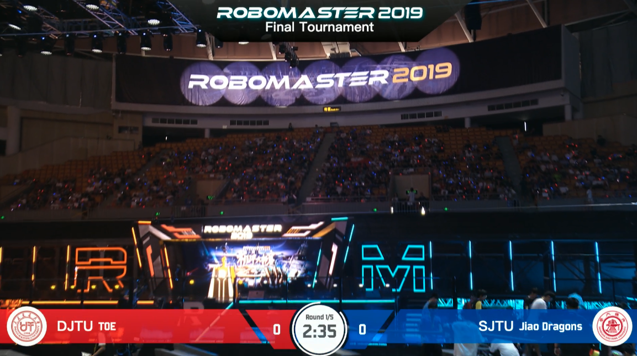
What About This
Notes:
A bridge in between? For us?
Then what’s better for us, the undergraduate students? Challenging and yet fun.

Slide 8
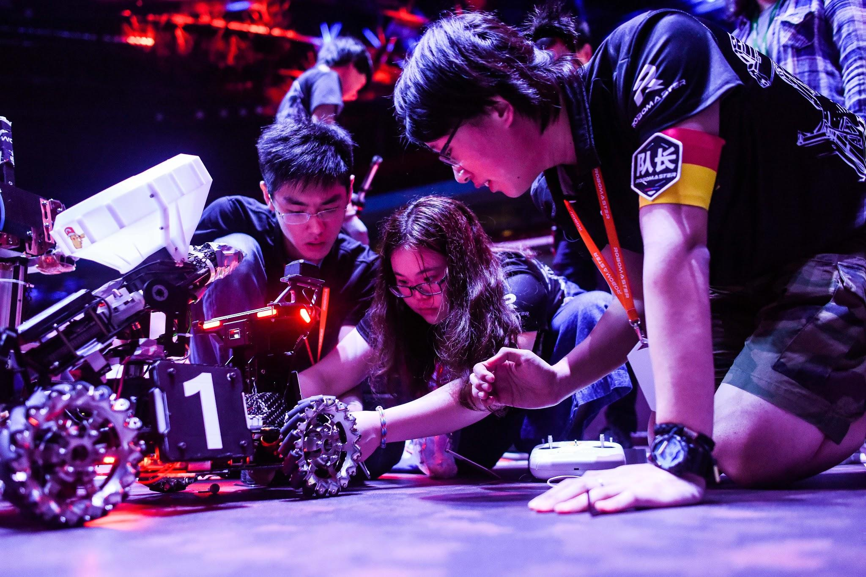
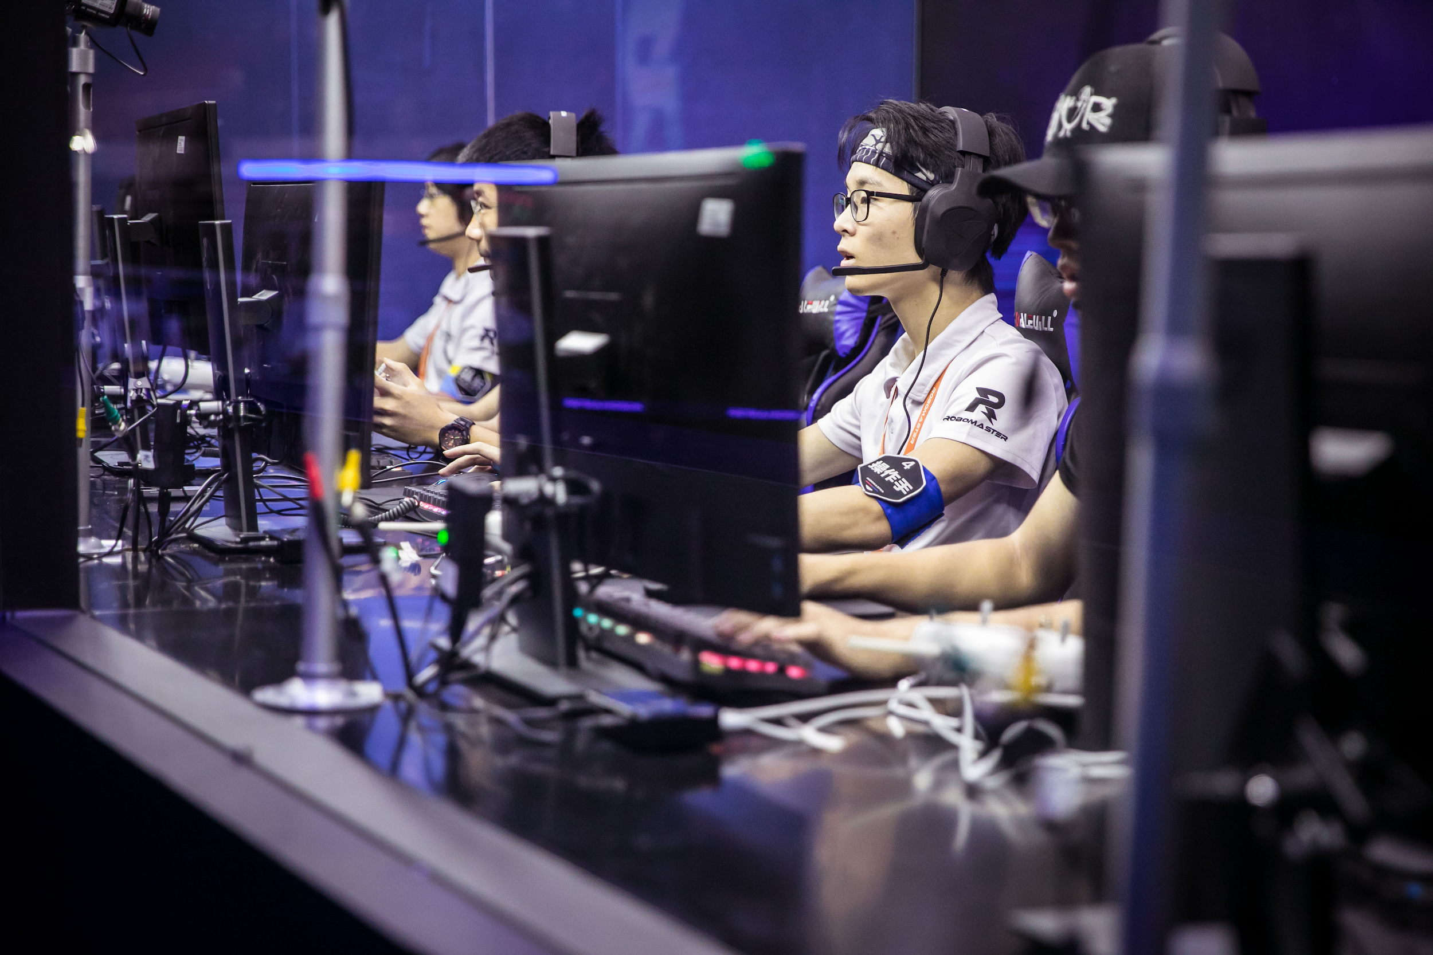
Your Reasons to Be Here
Photo credits: http://innowing.hk/robomaster2019/

Slide 9
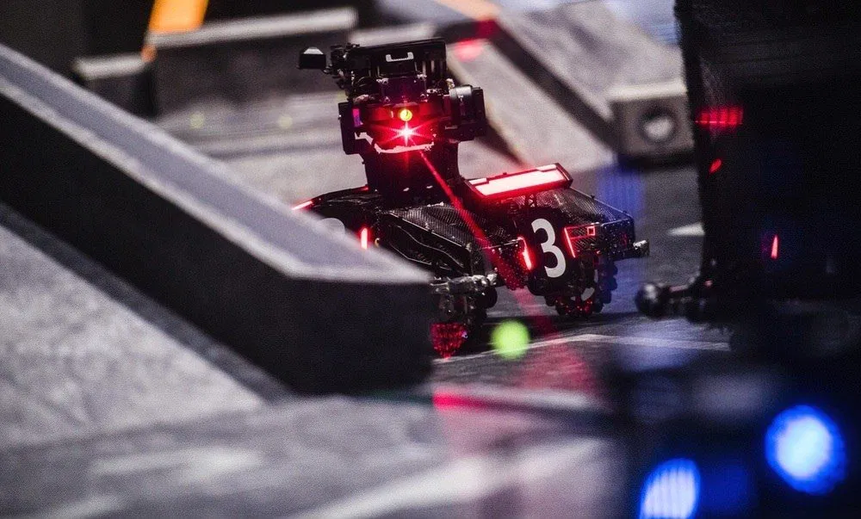
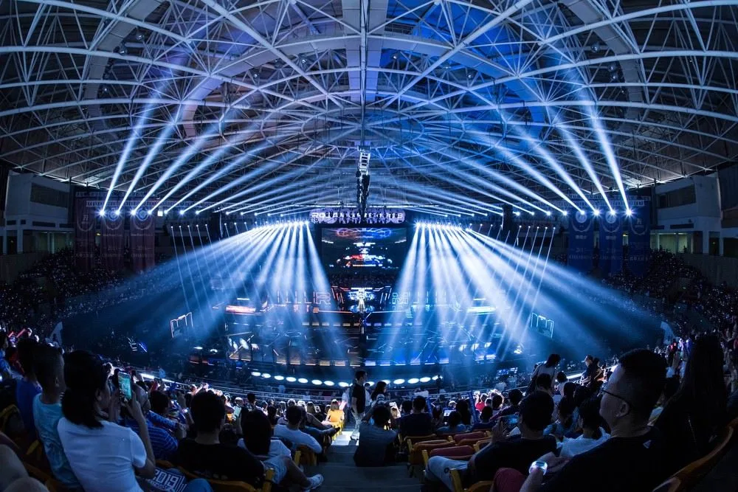
170+ Teams 10,000 Young Engineers
10+ Countries
4 Regionals
Image credits: https://dronedj.com
Notes:
Some more numbers for you

Slide 10
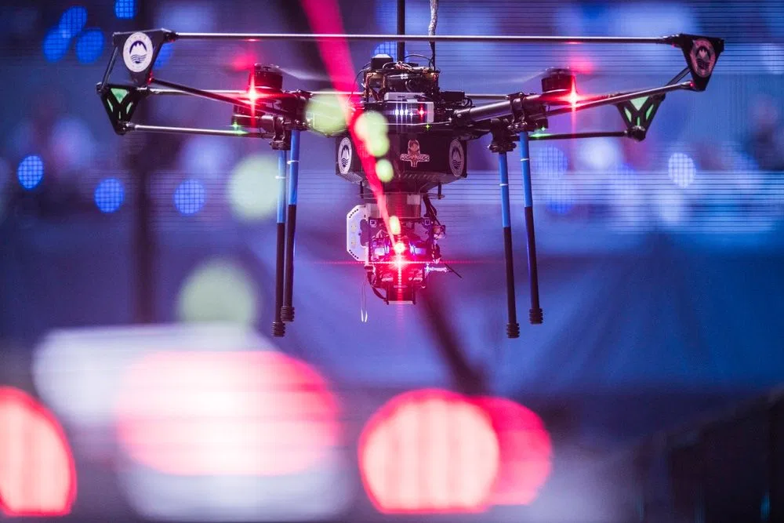
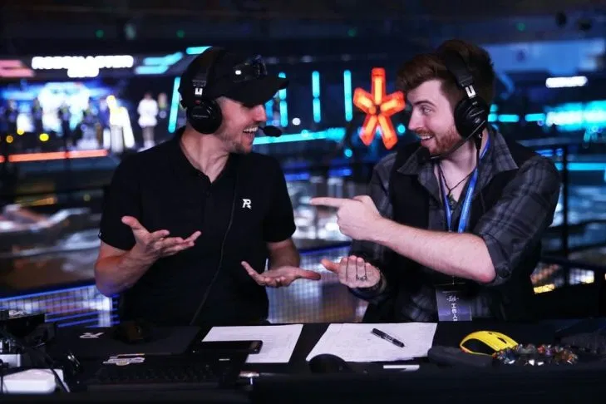
Prize Poll S$750,000
Grand Prize S$100,000
1.95M Online Viewers
3 Broadcast Languages
Image credits: https://dronedj.com

Slide 11
Final
Tournament
Winners
2019

Slide 12
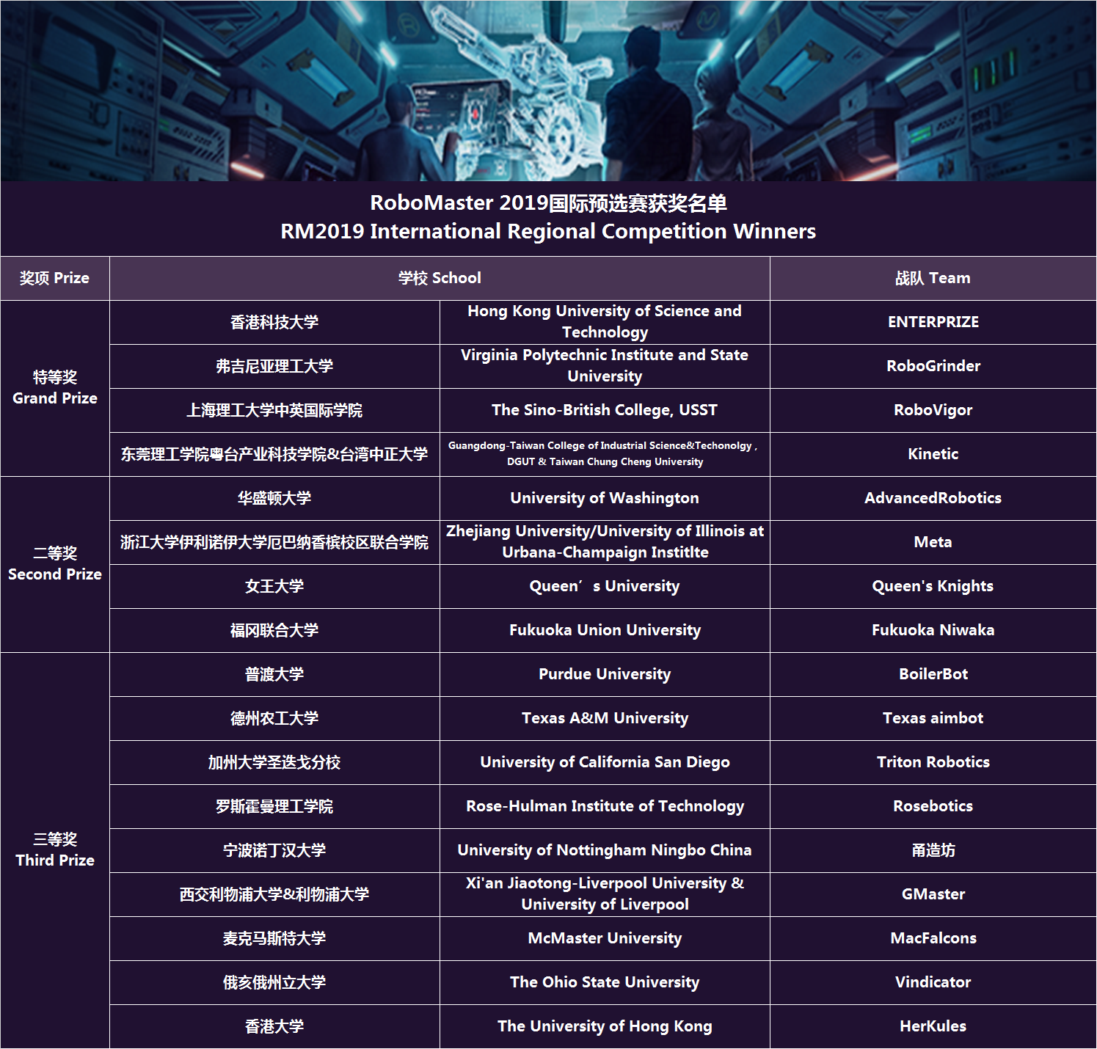
International Regional Competition
Winners
2019

Slide 13
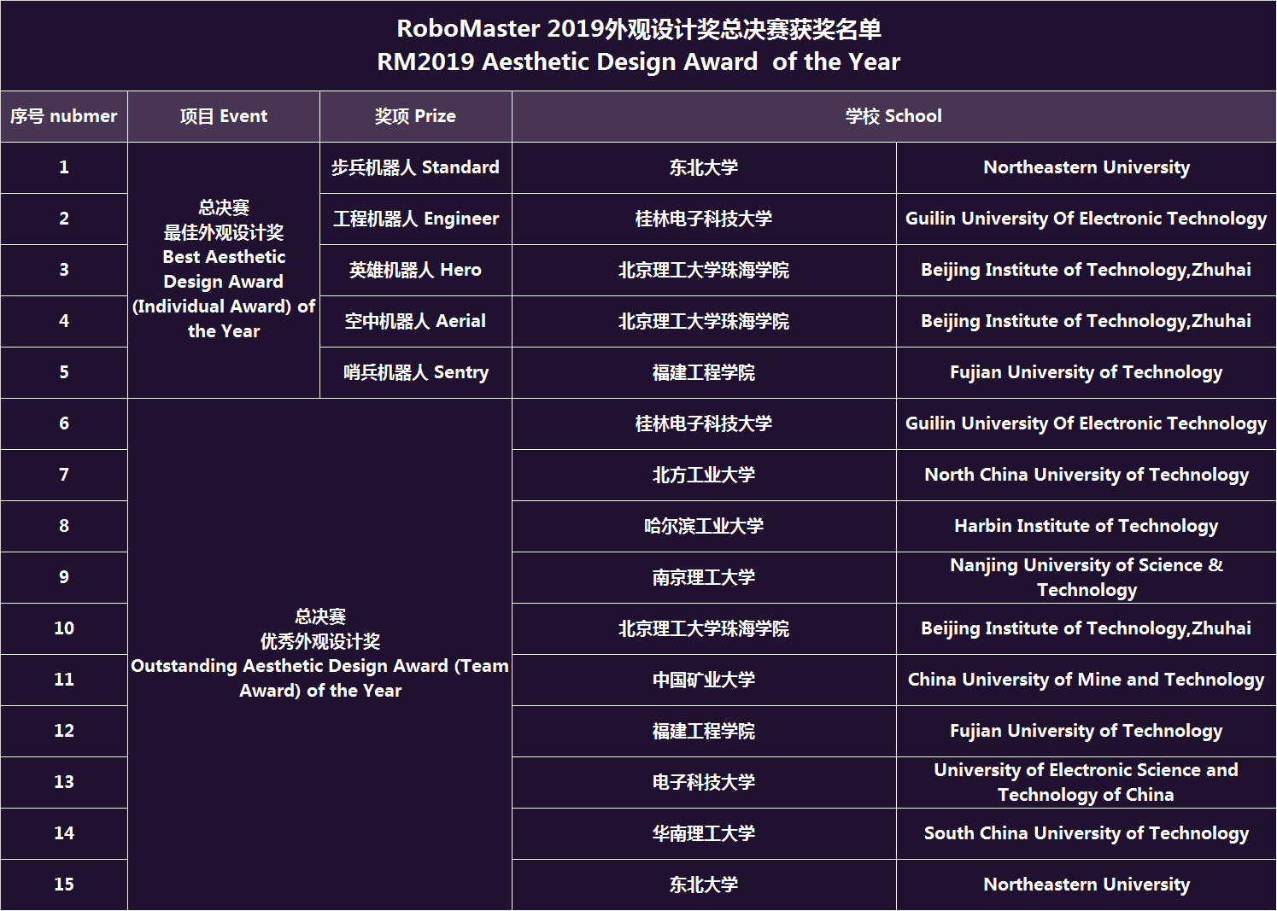
Aesthetic Design Award
2019

Slide 14
Check Yourselves...
Time Commitment
For a year (2020 Aug), (one of) your most important CCAs
Teamwork
Able to find your teams, or willing to meet new people
Self-Learning Capabilities
It is NOT a teaching module, so no teaching materials
Create your own materials along the way

Slide 15
Welcome Onboard NUS RoboMaster Team 2020

Slide 16
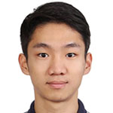
People to Know
Brian Shohei Teo (engtsb@nus.edu.sg) (part of iDP)
Cheng Huimin (tslchh@nus.edu.sg) (Staff at T-Lab)
Research Interests: Visual SLAM, Image Enhancement
Suzanne Koh (engkohs@nus.edu.sg) (Staff at Office of Student Life, Alumni & Development)

Slide 17
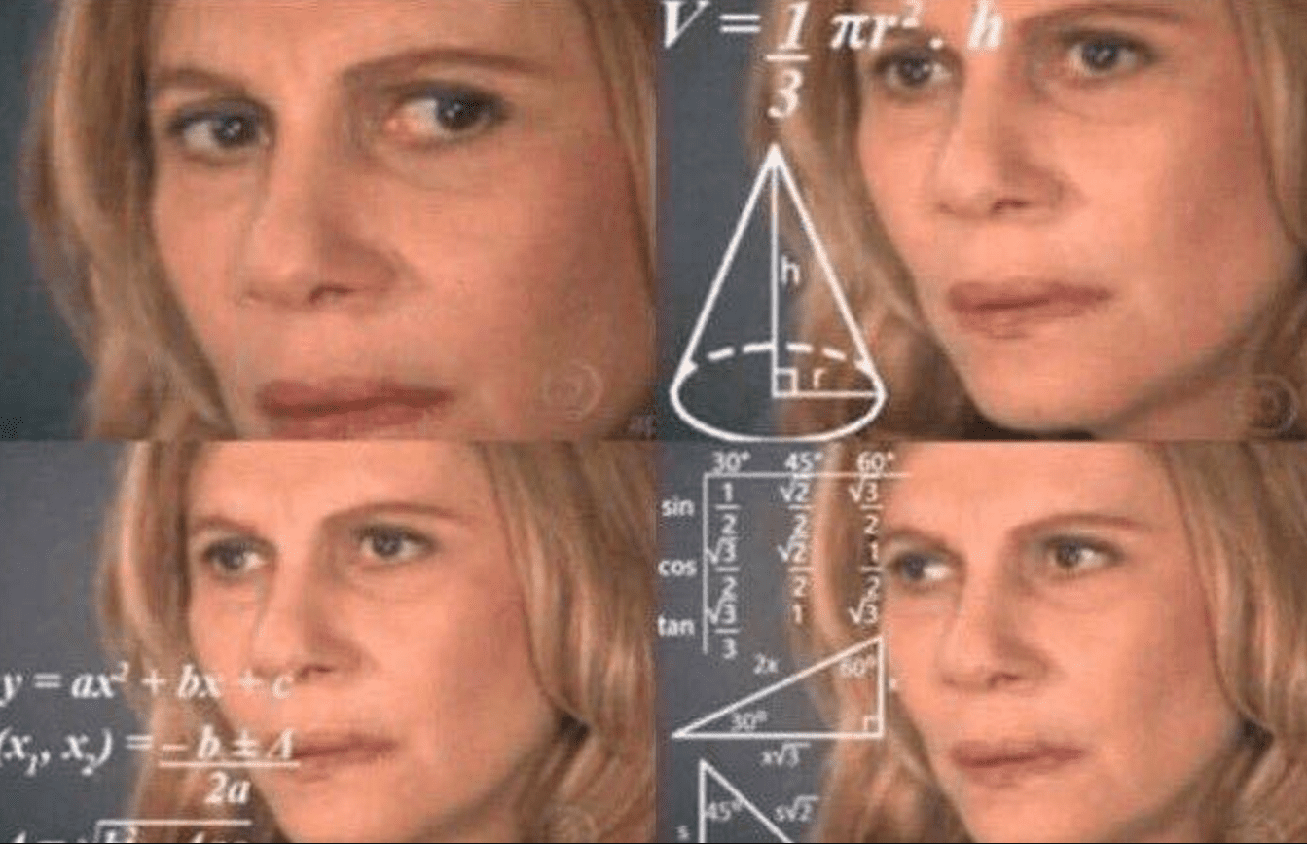
Goals of Today
What is Robomaster?
Who do I work with?
What do I need to do?

Slide 18
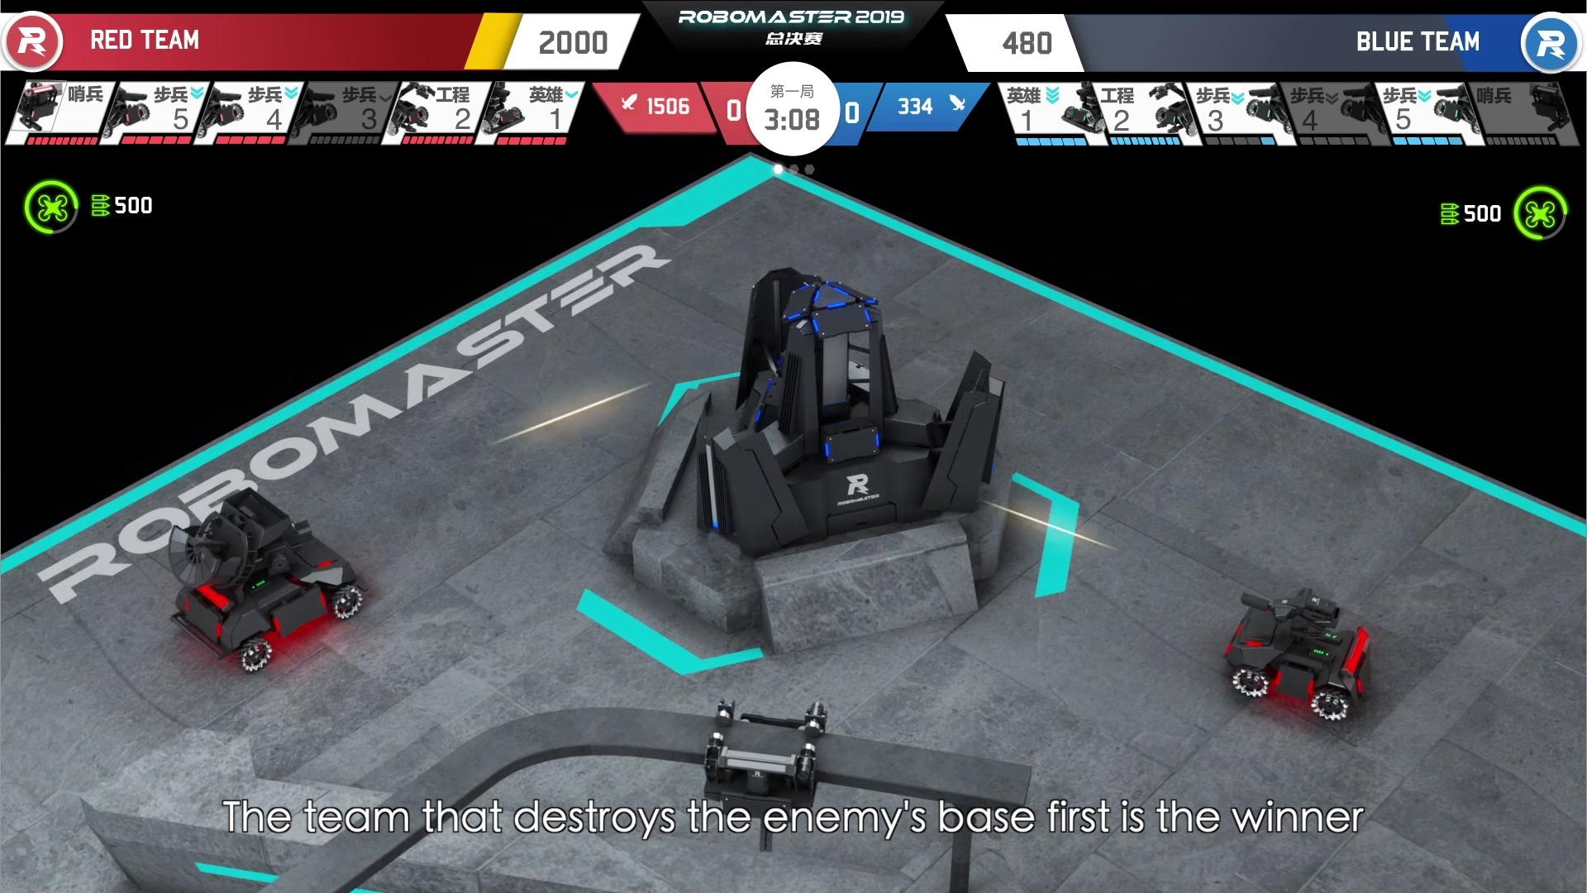
Rules video

Slide 19
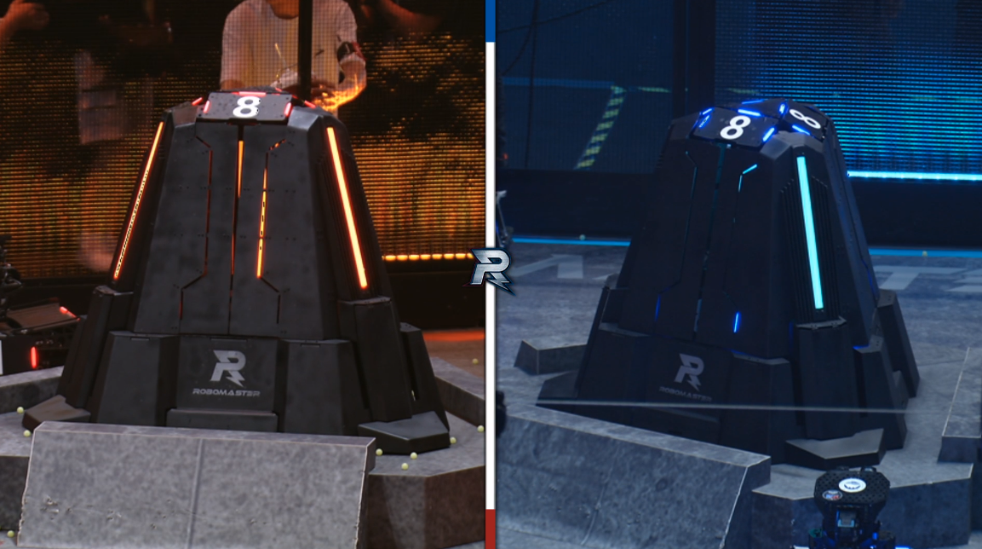
Main video

Slide 20
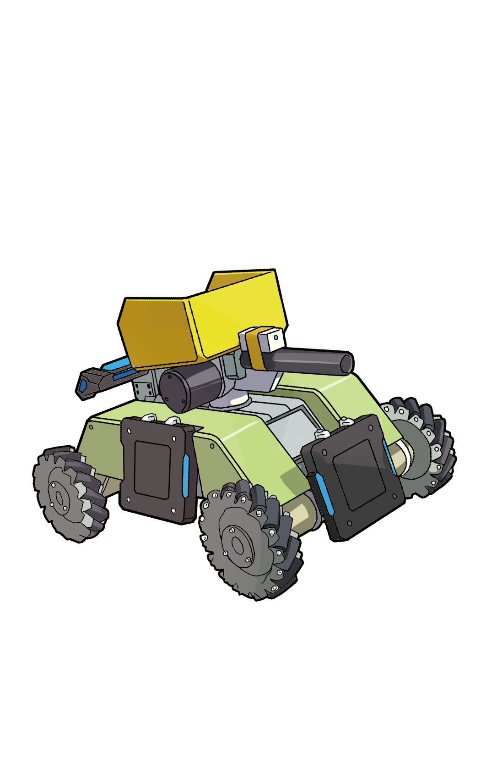
Robots in Use

Slide 21
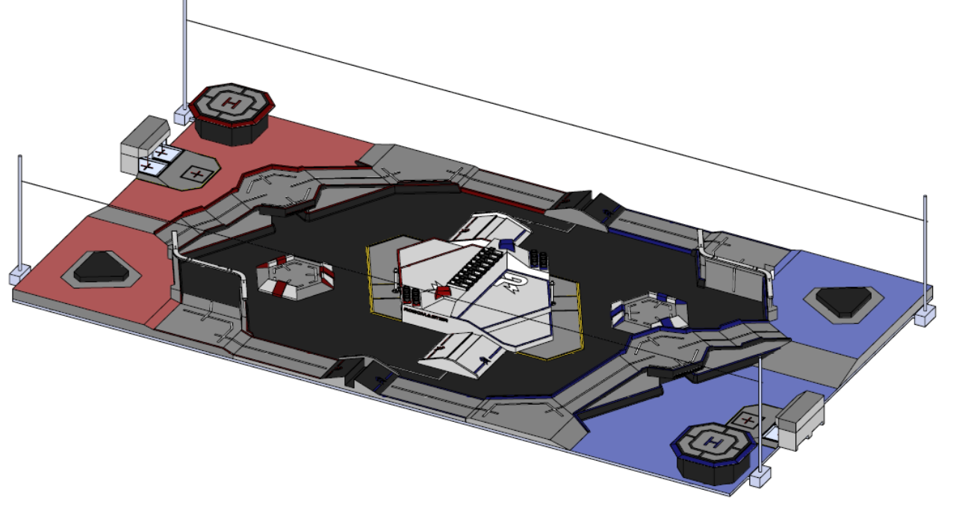
Field

Slide 22
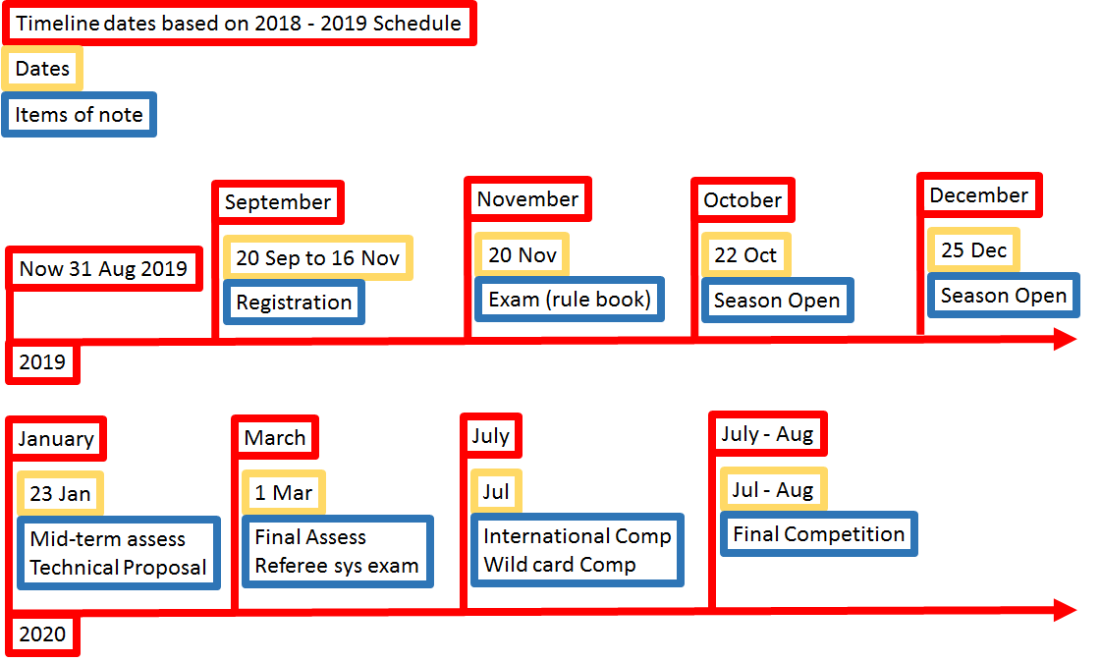
Timeline

Slide 23
Assignment
Form Teams of 3~5 (Core Team)
Registration form (personal particulars), submit by email
Team could recruit more people after October
Robomaster Room Committee
At least one member from each team in the committee
Manage team assets, ensure safety
Arrangement for wall deco, sofa, chairs, water dispenser etc.

Slide 24
Assignment
Set Up a Team Webpage, on GitHub Pages
At least one member learn how to use Git, and static site generator
An example is given
You are free to create contents, but minimally Point 4
Brianstorm 1 Soldier Robot Proposal
Collect information from publicly available past competition sources
Key aspects of the robot to consider
General design and fabrication methods
Timeline and manpower plan

Slide 25
Assignment
Submission Deadline: 16th September 2019 Submission through GitHub Pull Request
https://nusrobomaster.github.io

Slide 26
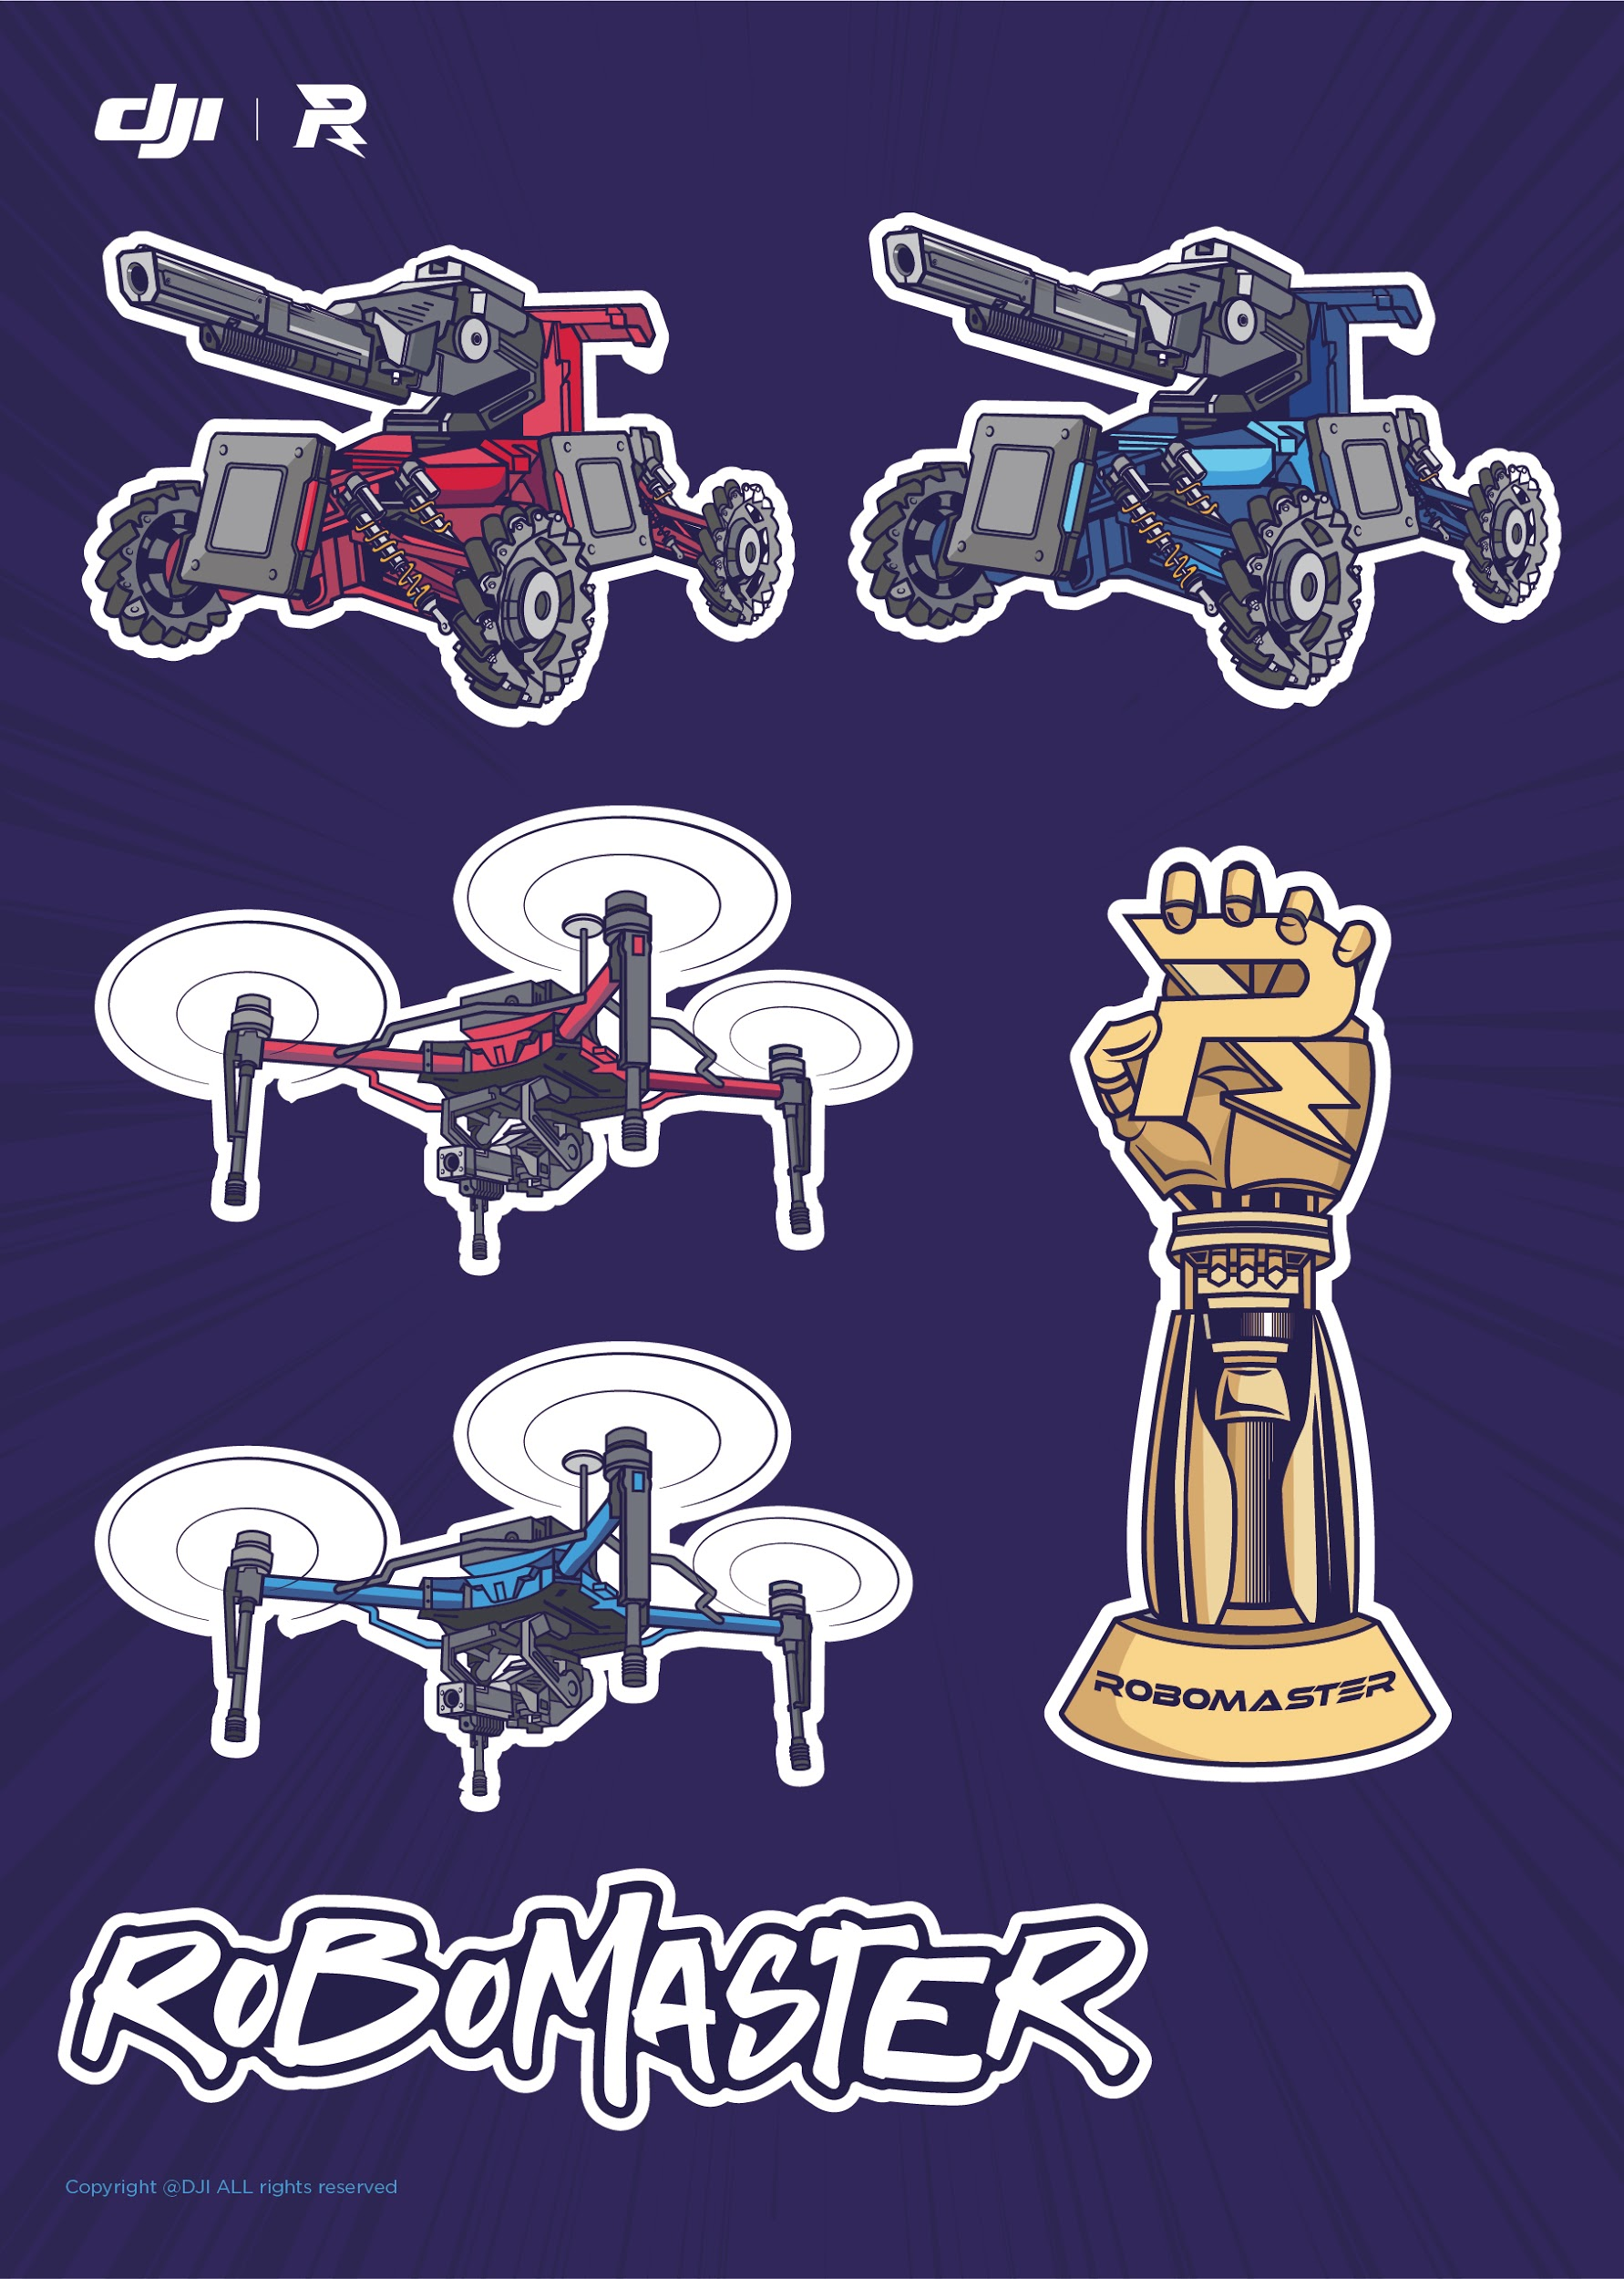
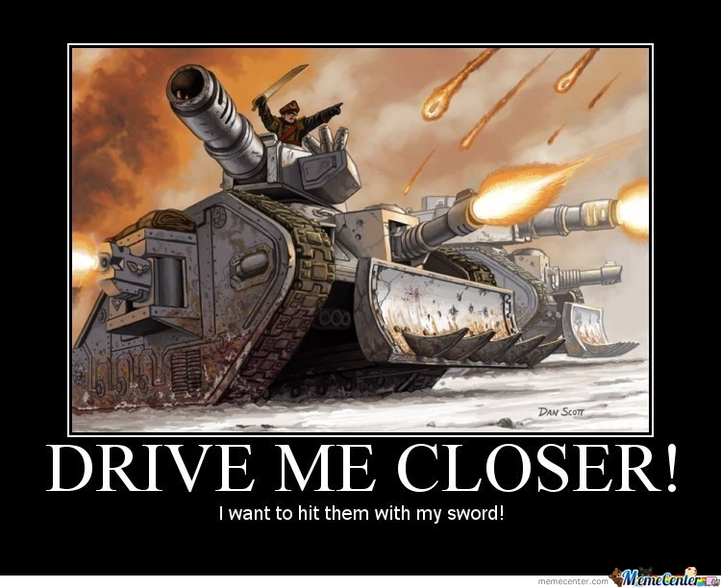
End
Robomaster room visit
Team registrations

Slide 27
Possibilities are in Your Hands

